Slide 1
Discover all the clues to good vision
Children’s Vision for Students

Slide 2
Your eyes…
Are about as big as a ping-pong ball
Sit in a little hollow area in your skull (called the eye socket)
Are protected at the front by the eyelid
Are kept clean by blinking
Are connected to your brain by a little cable called the optic nerve

Slide 3
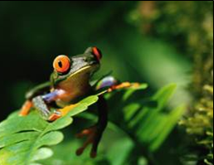
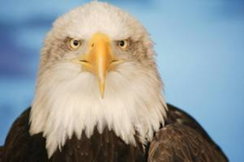
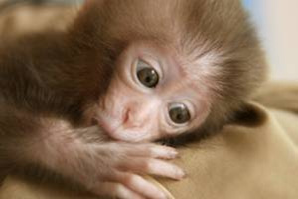
Eyes are very different
What differences can you see?

Slide 4
What makes up your eye?

Slide 5
Let’s take a look inside.
Veins
Optic nerve
Macula

Slide 6
How do I see things?

Slide 7
What happens when I look at things?
Brain
Eye

Slide 8
Looking after your eyes
Wear sunglasses and a hat when you are outside
Eat lots of vegetables, fruits, nuts and fish
Rest your eyes from the phone, computer or TV
Use a good light when reading
Spend a few hours each day outdoors, in natural daylight
Tell mum or dad if you think there is a problem with your vision or eyes

Slide 9
All eyes are different
Everybody’s eyes see the same things a bit differently
Some people have trouble seeing things up close and some people have trouble seeing far away
Many people need glasses to help them see clearly

Slide 10
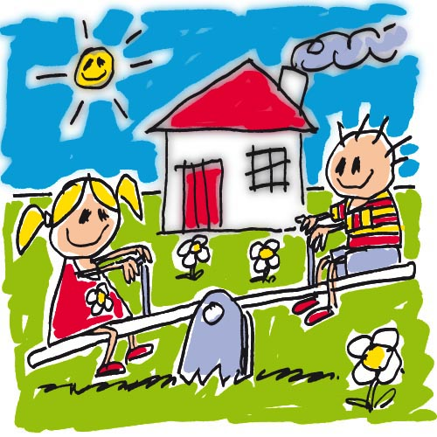
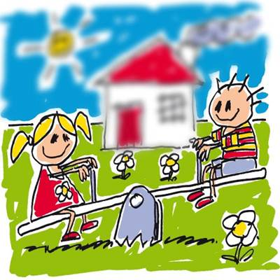
Near sighted
Can see clearly up close but things in the background can be blurry

Slide 11
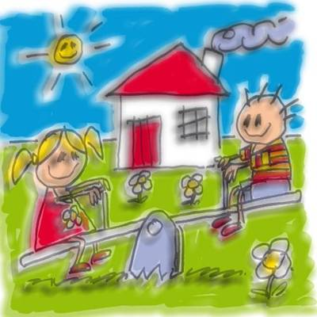
Astigmatism
Front of the eye is shaped like an Aussie rules football instead of a basketball, making some things blurry

Slide 12
Colour vision problem
Colours are not seen as they should be

Slide 13
Any questions?
Optometry Australia
www.goodvisionforlife.com.au

Slide 14
For teachers: Facts
1 in 5 children has an undetected eye problem
Good vision is important for your students social, educational and behavioural development
Early detection is key

Slide 15
For teachers: How can I help?
Ensure a good vision classroom
Know the signs that may indicate a vision problem in your students
Advise parents of possible concerns

Slide 16
For teachers: How can I help?
Ensure a good vision classroom
Ensure good and even lighting
Limit computer sessions to less than two hours
Minimise reflections from the monitor
The top of the monitor should be approximately at or slightly below eye level
Use appropriate font sizes and colours on the monitor and whiteboard
Encourage outdoor activities at lunch and recess
Make sure sunglasses and a hat are worn outdoors
Make sure appropriate protective eyewear is worn when playing sport

Slide 17
For teachers: How can I help?
Know the signs that may indicate a vision problem in your students
One eye turns in or out while the other points straight ahead
Frequent blinking or rubbing the eyes
Poor hand-eye coordination
Difficulty learning to read, below age-average reading skills
Complaints of headaches
Red or watery eyes

Slide 18
For teachers: How can I help?
Advise parents of possible concerns
If you think a student may have an eye problem, speak to parents.
Recommend that the parent take their child to an optometrist for a thorough eye examination.

Slide 19
More information
Download children’s vision resources for teachers at Good vision for life or contact your local optometrist.

