Slide 1
Diabetes & vision

Slide 2
Contents
Diabetes facts
Changes to the eyes with diabetes
Diabetic retinopathy
  Background retinopathy
  Proliferative retinopathy
Diabetes and glaucoma
Diabetes and cataract
Diabetes and refractive errors

Slide 3
Diabetes facts
Nearly 5% of Australians have diabetes
More than 70% of people with diabetes will develop diabetes related eye problems within 15 years of diagnosis

Slide 4
Changes to the eyes with diabetes
Blurred vision
Fluctuating vision
Can occur early on in the disease
An optometrist will often be the first person to pick up that someone has diabetes

Slide 5
Changes to the eyes with diabetes
Changes to retinal blood vessels (retinopathy)
Increased likelihood of
  Cataract
  Glaucoma
Changes to refractive error

Slide 6
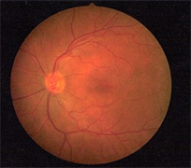
Normal retina
Retinal blood vessels
Optic nerve
Macula

Slide 7
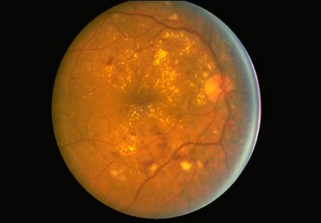
Diabetic retinopathy
Background retinopathy
  rarely causes loss of vision. You still see ‘well’.
  no treatment required
  need to monitor regularly

Slide 8
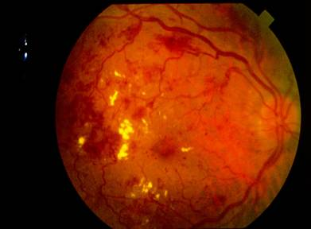
Diabetic retinopathy
Proliferative retinopathy
  more serious
  requires early treatment
  significant loss of vision can occur

Slide 9
Diabetic retinopathy risk depends on:
Length of time you have had diabetes
How well your blood sugar level is controlled

Slide 10
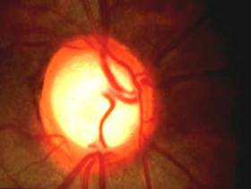
Glaucoma
Disease of the optic nerve
Affects peripheral vision first
Difficult to detect in the early stages
Slightly more common if you are diabetic

Slide 11
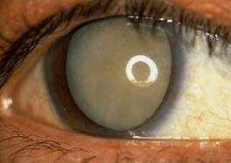
Cataract
Clouding of lens inside eye
Gradual loss of vision
Increased awareness of glare
Occurs at an earlier age if you are diabetic

Slide 12
Refractive errors
Myopia
  Short-sightedness
Hyperopia
  Long-sightedness
Astigmatism
  Corneal irregularity
Presbyopia
  Loss of close vision with age

Slide 13
Regular eye tests are vital if you have diabetes
Every 12 months OR more often if you have some form of retinopathy
No referral is required
Diabetic examinations attract a Medicare rebate
Find your local optometrist here:
www.optometry.org.au/find-an-optometrist/

Slide 14
Optometrists
Provide a thorough vision and eye health exam
Detect and diagnose eye health problems
Prescribe and supply glasses and contact lenses when required
Diagnose and treat eye coordination and focusing problems

Slide 15
Read more about Diabetes & Eyes
www.goodvisionforlife.com.au/vision-problems/diabetic-retinopathy/

