Slide 1
ECOV/SA’s: Neuro-optometry/ophthalmology Webinar

Slide 2
Welcome
Chelsea Lane
Early Career Optometrists Victoria South Australia
Notes:
Hello and welcome everyone to the ECOV/SA: Neuro-optometry webinar
Thank you all for taking the time to attend our event tonight, we’ve had a great response from members, and we really hope you enjoy it.
My name is Chelsea Lane and I’m an Early Career Optometrists Victoria South Australia committee member and a practicing optometrist in regional Victoria.
In starting the event tonight, I’d like to acknowledge the Traditional Owners of the land on which we meet today. I pay my respects to their Elders, past, present and emerging, and the Aboriginal Elders of other communities who may be here today.

Slide 3
Program overview
ECOV/SA update
Chelsea Lane, committee member
Neuro- presentations with interactive learning sessions
Dr Jeremiah Lim
Rahul Chakrabarti
Close and evaluation
Notes:
On the screen is a the overview of tonight’s program.
Just confirming that there are 2.5 Therapeutic Interactive CPD Hours (if you complete assessment) for this evening, or 2 Therapeutic Interactive CPD Hours without assessment.

Slide 4
Learning objectives
To ensure that participants:
develop an understanding of how to triage the urgency of a neurological condition
be familiar with how different imaging modalities can help differentiate similar looking conditions
be able to apply this knowledge in a clinical setting
Notes:
Here are our learning objectives for the event this evening.
I won’t read them out as you will have seen them on the website already.

Slide 5
CPD attendance and assessment
→ elitecpd.optometry.org.au
Notes:
I’m now going to go through how to complete your CPD attendance and assessment for tonight’s event.
If you can pull out your phone and get it all setup now, that would be great.
Open your browser and go to elitecpd.optometry.org.au
Log in using your OA member number eg MXXXXXX
Password is your OA member password

Slide 6
CPD attendance and assessment
Notes:
Then you will be taken to the dashboard page:
Choose “ECOV/SA Neuro-Optometry Seminar” (need to check this)
Click on blue box to the right with the arrow, then click on the black and white PEN icon on right to record attendance, questions then appear
Just a reminder that you will have one week to complete assessment. So you can do it tonight if you want to, or sometime in the next week, but you need to submit your responses before next Monday.
If you’ve had any trouble logging in or following these instructions, please raise your hand and one of our committee members will try and assist you. Alternatively if we can’t sort it out for you tonight, contact the OV/SA office in the morning by phone or email, and they will be able to assist you.
Now I’m going to pass you onto Lyn

Slide 7
ECOV/SA update
Lyn Hsieh
Acting Member Services and Policy Manager
Notes:
Hello everyone, my name’s Lyn Hsieh, and I’d like to provide you with a quick update on some of ECOV/SA’s recent work, that we’ve undertaken on behalf of our members.

Slide 8
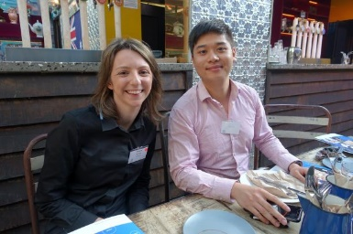
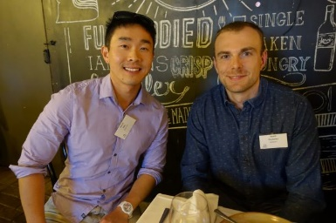
ECOV/SA events
Last ECOV/SA CPD seminar for this year
More events will be developed for 2022
Plan ahead using your OA CPD Learning Plan
Notes:
Just as a bit of background, ECOV/SA is a committee within OV/SA and is made up of early career optometrists who are practising in Victoria and South Australia.
As you will already know, we deliver CPD seminars (like the one tonight) that are specific to the needs of early career optometrists. This is the last ECO specific event for this year, but we’re looking forward to seeing you all at our 2022 events – with details available over the coming months.
Don’t forget that as part of the new OBA CPD requirements there is a requirement for optometrists to develop a CPD Learning Plan.
OA has developed an online tool to make this simple and easy – and it’s integrated with all the events on the OA website, which will include all the ECOV/SA events for 2022 once we have them finalised.
We hope this will make it easy for you to plan ahead. You can check out the new learning plan template by visiting the Institute of Excellence on the OA website.
Our Regional Peer Mentoring events had been on hold during most of 2020 and 2021 due to the COVID-19 pandemic. However we are hoping we’ll have these back on track in 2022.

Slide 9
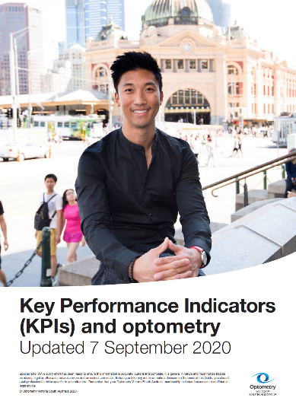
ECOV/SA resources
KPI resource
Home > Practice & professional support > Human resources & workplace relations
Notes:
Don’t forget that our Key Performance Indicators resource is available online for members and well worth a read.
The Optometry Australia website is very comprehensive and sometimes it can be a bit hard to find what you’re looking for.
But if you type in “KPI” into the search function it will take you to the Human Resources and workplace relations page, and the pdf is down the bottom under resources.

Slide 10
ECOV/SA survey of members
Demographics
Brief survey of members to inform our participation at OA’s National ECO Think Tank in Sept/Oct
57 eligible survey respondents
44 practice in Victoria
13 in SA
Most respondents practice in corporate (n=24) or independent (n=23)
Notes:
I also wanted to provide you with a quick report back on some of the key findings from a recent survey that we conducted of early career optometrists, to help inform our contribution to the recent OA National ECO Think Tank meeting that a couple of our committee members attended

Slide 11
Member priorities
Highest priority – Ensuring Diversity of Job Opportunities
Developing Collaborative Care Models
Oversupply of Optometrists
Improving the Diversity of Opportunities
Eye care in Non-Traditional Locations
Increasing Scope of Practice
Developing Multidisciplinary Ophthalmology Outpatient Care Models
Specialisation Endorsement
Notes:
Lyn to talk

Slide 12
Member priorities
Scope of Practice Expansion
60% ranked Oral Medication endorsement as highest priority
Followed by YAG/PI and Intra-vitreal injections
Notes:
Lyn to talk

Slide 13
ECOV/SA contact details
Early Career Optometrists Victoria South Australia
earlycareeroptomvicsa@gmail.com
or contact the OV/SA office
e: office.vicsa@optometry.org.au
ph: (03) 9652 9100
Notes:
So that’s it for the ECOV/SA update.
If you have any questions about ECOV/SA please feel free to contact us through our Facebook page or through the OV/SA office.
Back to Chelsea

Slide 14
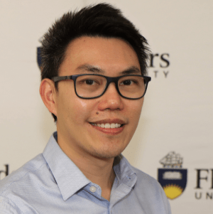
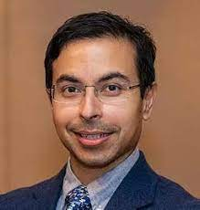
Dr Jeremiah Lim Dr Rahul Chakrabarti
Speakers
Notes:
Thanks Lyn.
I’d now like to introduce our guest speakers:
Dr Jeremiah Lin Jeremiah graduated from Melbourne University in 2009. As an optometrist, he has worked across more than 50 locations in Victoria.
His PhD completed in 2018 involved looking at ocular manifestations of neurological disease such as Alzheimer’s disease and common mechanisms in neurodegeneration between the eye and brain. His research interests include the application of retinal electrophysiology and OCTA as biomarkers for disease.
Prior to his appointment as senior lecturer at Flinders, he was a clinical teaching instructor and demonstrator at Melbourne University for 10 years.
He is currently the Placement Education Coordinator for the optometry program at Flinders and Associate Editor for Optometry Australia’s journal, Clinical and Experimental Optometry.
Dr. Rahul Chakrabarti Dr Rahul Chakrabarti is a trained general ophthalmologist who completed his medical training at Monash University in Melbourne. Dr Chakrabarti completed his internship and residency at the Royal Melbourne Hospital, his Masters of Surgical Education at the University of Melbourne and his ophthalmology training at the Royal Victorian Eye and Ear Hospital.
Dr Chakrabarti’s is dedicated to delivering comprehensive management and can perform intra-vitreal injections and laser for both glaucoma and retinal conditions. He has additional sub-specialty training in adult and paediatric strabismus as well as neuro-ophthalmology, completing his fellowships at the Royal Victorian Eye and Ear Hospital and The Alfred.
Dr Chakrabarti is one of the first faculty involved with virtual reality cataract surgery stimulation training of eye registrars in Australia. He is a supervisor of Senior Eye Registrars and the chief eye registrars at the Eye and Ear Hospital.
Please welcome Dr Jeremiah Lim and Dr Rahul Chakrabarti
After their presentation:
I’d like to now invite questions from the audience.
Once finished: I would like to thank both our speakers Rebekah Hopps and Dr Paul Athansiov who have provided really interesting and thought provoking presentations –thank you!

Slide 15
Interactive Breakout Session
Notes:
Please note you will be required to participate in the breakout sessions by turning on your cameras and microphones to receive interactive hours.

Slide 16
Evaluation and Close
Notes:
So that’s it for this evening.
Thank you everyone for being part of tonight’s event. It’s been a fantastic event and I really hope you’ve enjoyed it.
Can I please also ask you to complete an evaluation form before you leave tonight. It is found online with a link sent to you via email confirmation from Lisa Busuttil on Thursday last week. We genuinely use the information to help develop and refine other CPD events – so please if you could take the time to complete it, we would really appreciate it.
I hope you all have a fantastic rest of the evening. Stay safe, stay well and we look forward to seeing you all again soon. Good night.

