Slide 1
CASE STUDY 1
DR RAHUL CHAKRABARTI, FRANZCO
NEURO-OPHTHALMOLOGY
EARLY CAREER OPTOMETRY SESSION, 29TH NOVEMBER, 2021

Slide 2
PRESENTING COMPLAINT
61 yo female
3 day history of pain behind right eye
Constant, dull ache, radiation to the jaw
No aggravating or alleviating factors
Had a slipped from a chair landing on head + neck in the week prior, no loss of consciousness
No trauma / chiropractic treatment
Past ophthalmic history: reading glasses only
Medical history: high cholesterol (controlled with a tablet)
Nil allergies
Social history: non smoker, nil alcohol

Slide 3
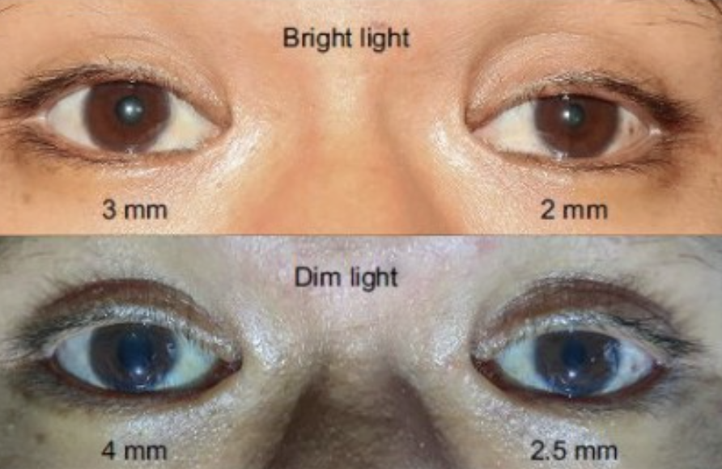
examination
VA OD 6/6 OS 6/12 (no improvement with pinhole)
IOP 17 A 18
Ocular motility: full
Slit lamp exam – normal anterior and posterior segment. Normal discs.
Pupils (see photo)

Slide 4
questions
What is your diagnosis?
What are your differentials, and why?
If this patient came into your daily clinic, how would you manage them?
Further history
Further examination / in-clinic tests
Referral (if necessary, urgency of that and why?)

