Slide 1
Keratoconus Webinar
Notes:
Holding slide

Slide 2
Welcome
John De Francesco
Early Career Optometrists Victoria South Australia
Notes:
Hello and welcome everyone to the ECOV/SA: Keratoconus webinar.
Thank you all for taking the time to attend our event tonight, we’ve had a great response from members, and we really hope you enjoy it.
My name is John De Francesco and I’m an Early Career Optometrists Victoria South Australia committee member and a practicing optometrist in Melbourne.
In starting the event tonight, I’d like to acknowledge the Traditional Owners of the land on which we meet today. I pay my respects to their Elders, past, present and emerging, and the Aboriginal Elders of other communities who may be here today.

Slide 3
Program overview
Optometry Victoria South Australia update
Michelle Marven, Member Services and Policy Manager
Keratoconus Webinar
Jessica Chi
Dr Georgia Cleary
Interactive Case Session
Pooja Bhindi
Close and evaluation
Notes:
On the screen is a the overview for tonight’s program.
Just confirming that there are 2.5 Therapeutic Interactive CPD Hours (if you complete assessment) for this evening, or 2 Therapeutic Interactive CPD Hours without assessment.

Slide 4
Learning objectives
To ensure that participants understand:
How to manage keratoconus in the primary eye care setting.
How to develop a collaborative approach to the management of keratoconus: from clinical suspicion to diagnosis and treatment.
Notes:
Here are our keratonus learning objectives for the event this evening.
I won’t read them out as you will have seen them on the website already.

Slide 5
CPD attendance and assessment
→ elitecpd.optometry.org.au
Notes:
I’m now going to go through how to complete your CDP attendance and assessment for tonight’s event.
If you can pull out your phone and get it all setup now that would be great.
Open your browser and go to elitecpd.optometry.org.au
Log in using your OA member number eg MXXXXXX
Password is your OA member password

Slide 6
CPD attendance and assessment
Notes:
Then you will be taken to the dashboard page:
Choose “ECOV/SA Seminar Keratoconus”
Click on blue box to the right with the arrow, then click on the black and white PEN icon on right to record attendance, questions then appear
Refer to the assessment images and questions that have been emailed to you (and that will be on the website tomorrow), and use these to answer the questions in elitecpd.
Just a reminder that you will have one week to complete assessment. So you can do it tonight if you want to. Or you can access a recording of this presentation, and the assessment images and questions from the website (we’ll send you the link) and you’ll have until next Monday to complete it. If you’ve had any trouble logging in or following these instructions, please write this in the chat and one of the OV/SA staff will be able to assist you. Alternatively contact the OV/SA office in the morning.

Slide 7
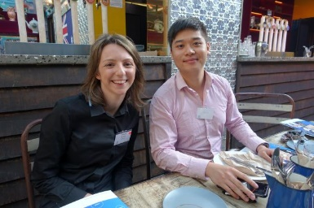
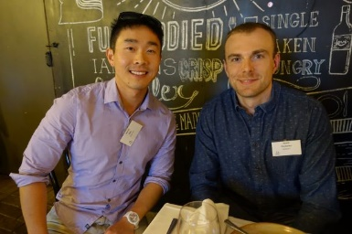
ECOV/SA events
ECOV/SA CPD seminar 2021
Anterior Eye – 11 October
All CPD events on OA website
Plan ahead using your OA CPD Learning Plan
Notes:
Before we move on I’d like to provide a brief update on the work of ECOV/SA.
ECOV/SA is a committee within OV/SA and is made up of early career optometrists who are practising in Victoria and South Australia.
As you will already know, we deliver CPD seminars (like the one tonight) that are specific to the needs of early career optometrists. There will be more events planned til the end of 2021. Information will be available soon.
Don’t forget that as part of the new OBA CPD requirements there is a requirement for optometrists to develop a CPD Learning Plan.
OA has developed an online tool to make this simple and easy – and it’s integrated with all the events on the OA website, which will include the ECOV/SA events once we have them finalised.
We hope this will make it easy for you to plan ahead. You can check out the new learning plan template by visiting the Institute of Excellence on the OA website.
Our Regional Peer Mentoring events had been on hold during most of 2020 and 2021 due to the COVID-19 pandemic. We are planning to hold our event in Victor Harbor (SA); however, our events in Mildura and Wangaratta are on hold for now.
You can see the locations on the screen for upcoming events which will be held in the next couple of months. You do need to RSVP (for catering purposes) and you can find the events on the OA website in the CPD calendar. They’re a great way to catch up with peers and friends and meet new people in your local area, over a delicious lunch or dinner and drinks. It’s free to attend and the cost of your meals and drinks are paid for by OV/SA.
All pending any Government directives at the time of course.

Slide 8
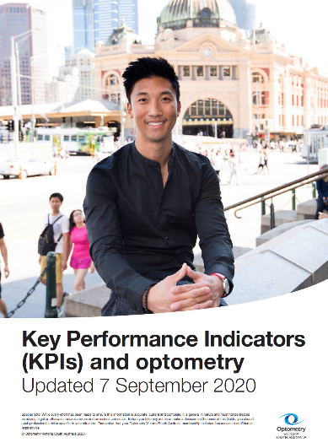
ECOV/SA resources
KPI resource
Home > Practice & professional support > Human resources & workplace relations
Notes:
Don’t forget that our Key Performance Indicators resource is available online for members and well worth a read.
The Optometry Australia website is very comprehensive and sometimes it can be a bit hard to find what you’re looking for.
But if you type in “KPI” into the search function it will take you to the Human Resources and workplace relations page, and the pdf is down the bottom under resources.

Slide 9
ECOV/SA contact details
Early Career Optometrists Victoria South Australia
or contact the OV/SA office
e: office.vicsa@optometry.org.au
ph: (03) 9652 9100
Notes:
So that’s it for the ECOV/SA update.
If you have any questions about ECOV/SA please feel free to contact us through our Facebook page or through the OV/SA office.
I’ll now hand over to Michelle Marven who will provide a quick update on Optometry Victoria South Australia before we move into the program.

Slide 10
OV/SA update
Lyn Hsieh
Policy and Advocacy Coordinator
Notes:
Hello everyone, my name’s Lyn Hsieh, and I’d like to provide you with a quick update on some of OV/SA’s recent work, that we’ve undertaken on behalf of our members.

Slide 11
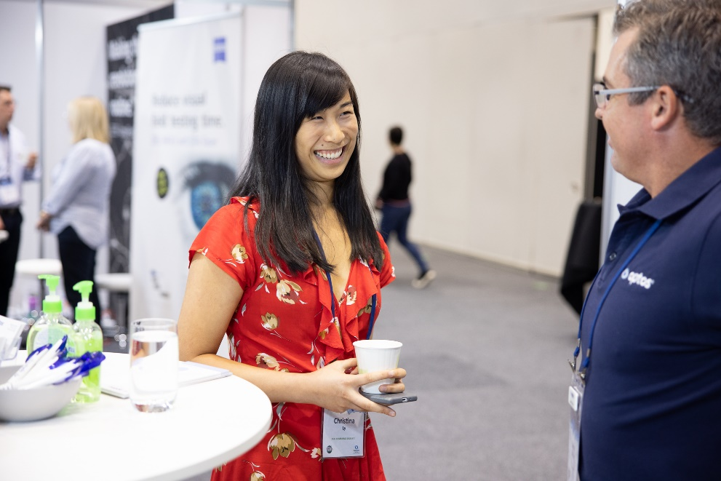
Events
SRC Online 2021
Planning 2021/2022
Notes:
SRC Online 2021 was held just a few weeks ago, with the event delivered online to over 950 attendees. If you participated I hope you enjoyed the event. CPD Hours are being uploaded to member’s CPD record and recordings are available for those who have registered –if you have any questions please do contact the office.

Slide 12
Advocacy
Statewide Referral Criteria (SRC) for public hospital ophthalmology
Came into effect on 1 May, 2021
For referrals related to: age-related macula degeneration, assessment for cataracts, corneal conditions, diabetic eye disease and glaucoma
More information
optometry.org.au and search ‘SRC Victoria’
Please share any feedback on SRC with OV/SA
Notes:
We’ve been working with the Primary Health Networks to align communication about this change to optometrists (which will be disseminated by OV/SA) and GP’s (which will be communicated by the PHNs). For each of the five areas identified above, patients are required to be referred to an optometrist or ophthalmologist first for a comprehensive eye and vision assessment, before being referred to a public ophthalmology clinic.
OV/SA member and rural optometrist Ken Thomas participated in the committee that developed the referral criteria, along with ophthalmologists, other key stakeholders and Department of Health senior staff.
Ophthalmology is the latest specialty area to have SRC applied, with 11 other conditions from cardiology to vascular disease having SRC applied.
We’re very keen to hear your feedback on how it’s going, so please let us know and we can pass on information to the Department of Health

Slide 13
COVID-19
Liaised throughout 2020 and 2021 with Victorian and SA governments
Weekly meetings with the Chief Allied Health Officer
Advocated for the profession while supporting sensible public health policy
Translated into regular member updates on changing conditions and requirements
Maintained regular communication with government and CAHO

Slide 14
Member resources
e-Wink monthly newsletter
Scope now electronic format
Updated Locum Guide
www.optometry.org.au/ practice-professional-support/ career-employment/working-as-a-locum/
SA Ophthalmology Directory
https://www.optometry.org.au/practice-professional-support/publications/state-publications/optometry-vic/
Notes:
In terms of our member resources, e-Wink is our electronic newsletter just for Victorian and South Australian members. As many of you know, it’s distributed monthly and is sent to your primary email in your member portal record. If you haven’t seen it, perhaps check that we have the right email address for you – and you can do that by logging in to the member portal. Also check your junk folder in case it’s been picked by your email spam filter.
Scope is our distributed quarterly and is also now online, with the next edition due later in March.
Don’t forget that our Locum Guide has key information on all aspects of working as a locum, including how to check if you really are a locum, or would be considered by the ATO to be an employee. You can find the guide on the OA website and the webpage address is on the screen.
The SA ophthalmology directory is also available online

Slide 15
Contact us
www.optometry.org.au
03 9652 9100
office.vicsa@optometry.org.au
Optometry Victoria South Australia
Notes:
So please do contact us if you have any questions or concerns, we’re always very happy to hear from you. That’s it from me at this stage, and I’ll now hand back to John for the rest of our event.

Slide 16
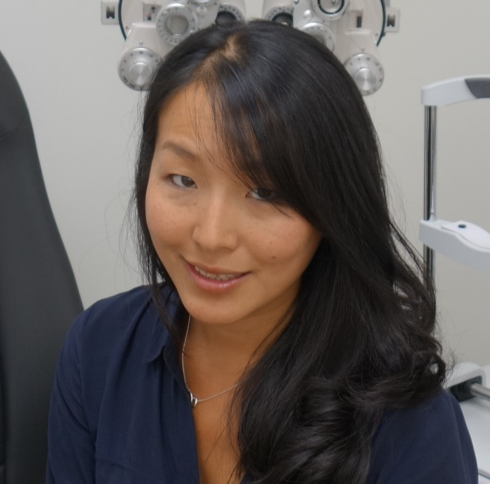
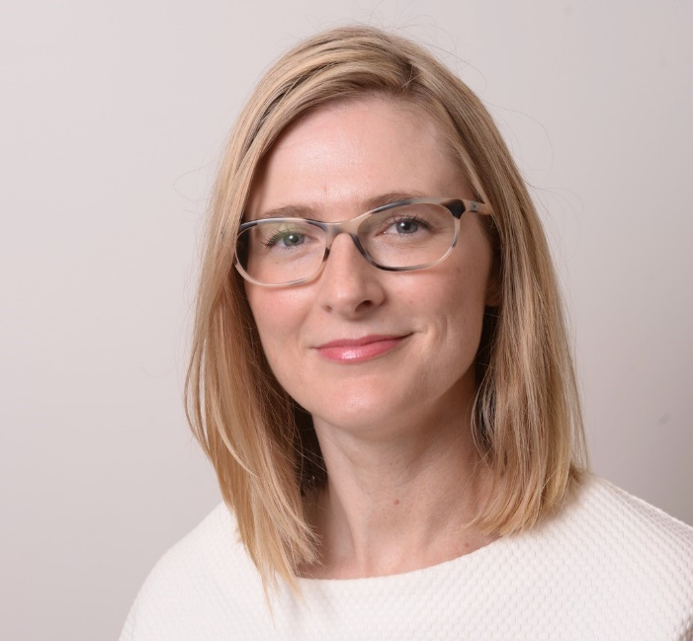
Jessica Chi Dr Georgia Cleary
Meet our Guest Speakers
Notes:
Thanks Michelle/Pete/Lyn.
I’d now like to introduce our guest speakers:
Jessica Chi Jessica Chi is the director of Eyetech Optometrists, an independent contact lens practice in Melbourne, which prescribes all forms of speciality contact lenses.
She is the current Victorian, and a past National President of the Cornea and Contact Lens Society and an invited speaker at meetings throughout Australia and beyond.
She is a clinical supervisor at the University of Melbourne, Lead Visionary for Sight For All's Contact Lens Projects, a columnist for Mivision, a member of the Optometry Victoria/South Australia's State Advisory Committee, and a fellow of the Australian College of Optometry and the British Contact Lens Association.
Dr Georgia Cleary is a cornea, refractive and cataract surgeon, working in both public and private practice in Melbourne, Australia. Her subspecialty clinical practice encompasses ocular surface and anterior segment disease in adults and children.
Georgia holds a public appointment as a consultant Ophthalmologist at RVEEH, working in the Corneal and Surgical Ophthalmology Services. She is the cataract surgery research lead for the Surgical Ophthalmology Service.
She works in private practice in East Melbourne, Brighton East and Frankston,
Please welcome Jessica Chi and Georgia Cleary.
After their presentation:
I’d like to now invite questions from the audience.
Once finished: I would like to thank both our speakers Jessica Chi and Dr Georgia Cleary who have provided a really interesting and thought provoking presentations –thank you!

Slide 17
Interactive Breakout Session
Notes:
I’d now like to introduce Pooja Bhindi – ECOV/SA Committee Representative who will introduce the cases for our Interactive Breakout Session.
Please note you will be required to participate in the breakout sessions to receive interactive hours.

Slide 18
Evaluation and Close
Notes:
So that’s it for this evening.
Thank you everyone for being part of tonight’s event. It’s been a fantastic event and I really hope you’ve enjoyed it.
Can I please also ask you to complete an evaluation form that will be sent to you via email in coming days. We genuinely use the information to help develop and refine other CPD events – so please if you could take the time to complete it, we would really appreciate it.
I hope you all have a fantastic rest of the evening. Stay safe, stay well and we look forward to seeing you all again soon. Good night.

